Slide 1
Educational Organisation Using ServiceNow
SlideMake.com

Slide 2
Introduction to Educational Organizations and ServiceNow
Educational organizations aim to enhance learning experiences through technology.
ServiceNow provides a platform for streamlining administrative and operational processes.
Integrating ServiceNow helps educational institutions improve efficiency and service delivery.
Notes:
Image source: https://n2.help

Slide 3

Key Challenges Faced by Educational Institutions
Managing large volumes of student and staff data efficiently.
Ensuring timely support for IT and administrative requests.
Maintaining compliance with educational regulations and data privacy laws.
Notes:
Image source: https://www.academiaerp.com

Slide 4

Overview of ServiceNow Platform
ServiceNow is a cloud-based platform designed for IT service management and beyond.
It offers modules like incident management, asset management, and workflow automation.
The platform is highly customizable to meet specific organizational needs.
Notes:
Image source: https://event.on24.com

Slide 5

Implementing ServiceNow in Education
Custom workflows can be created to handle student admissions, registration, and support tickets.
Integration with existing systems like Learning Management Systems (LMS) enhances functionality.
Training staff and students ensures effective adoption of the platform.
Notes:
Image source: https://www.slidemake.com

Slide 6
Student Support and Service Management
ServiceNow enables streamlined handling of student inquiries and support requests.
Automated ticketing reduces response times and improves student satisfaction.
Self-service portals empower students to find information and resolve issues independently.
Notes:
Image source: https://www.servicenow.com

Slide 7

IT Asset and Infrastructure Management
ServiceNow helps track and manage campus IT assets throughout their lifecycle.
It facilitates proactive maintenance and helps prevent system outages.
Real-time dashboards provide insights into infrastructure health and resource utilization.
Notes:
Image source: https://cdn.shopify.com

Slide 8
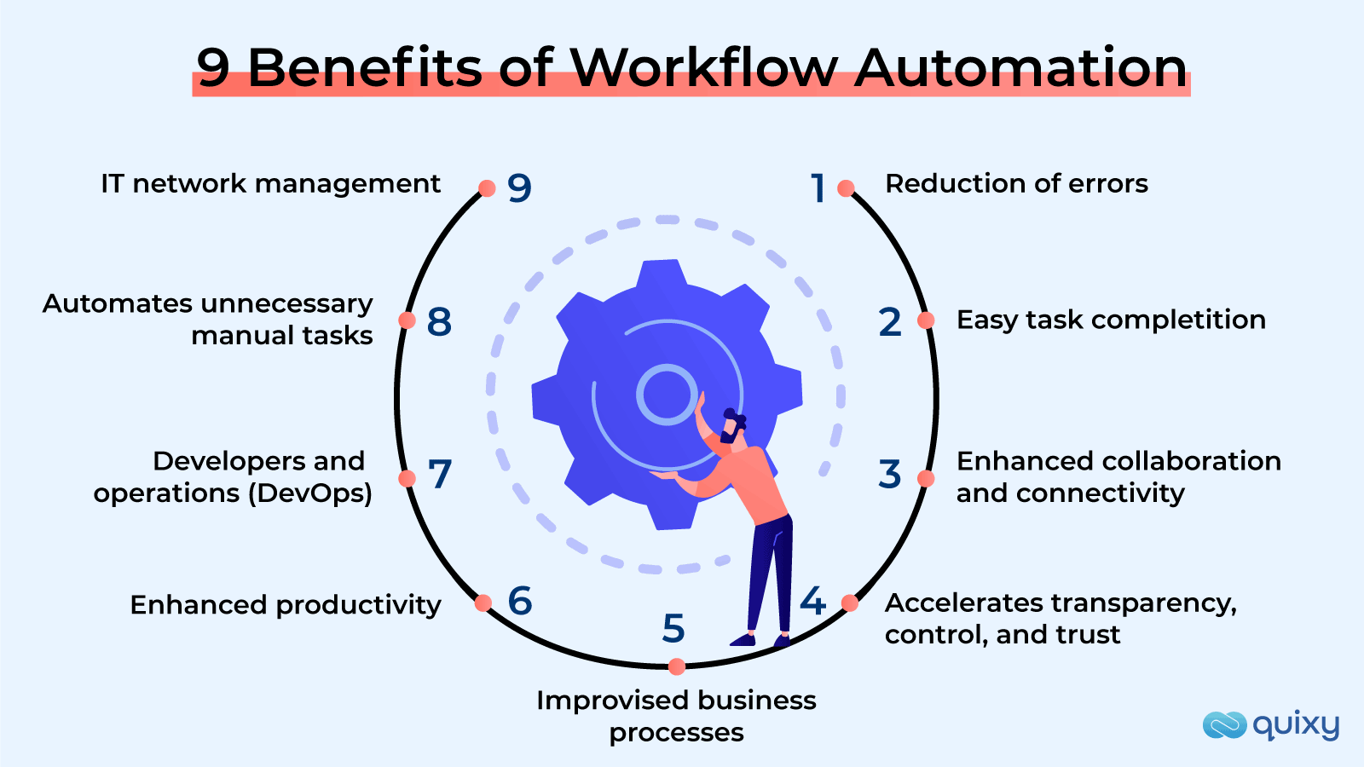
Workflow Automation and Process Optimization
Automating routine administrative tasks reduces manual effort and errors.
Custom workflows can streamline processes like course scheduling and faculty onboarding.
Automation enhances operational efficiency and allows staff to focus on strategic initiatives.
Notes:
Image source: https://quixy.com

Slide 9

Data Analytics and Reporting Capabilities
ServiceNow offers robust reporting features to monitor organizational performance.
Data-driven insights support decision-making and strategic planning.
Custom dashboards visualize key metrics related to student success and operational efficiency.
Notes:
Image source: https://www.nelsonfrank.com

Slide 10
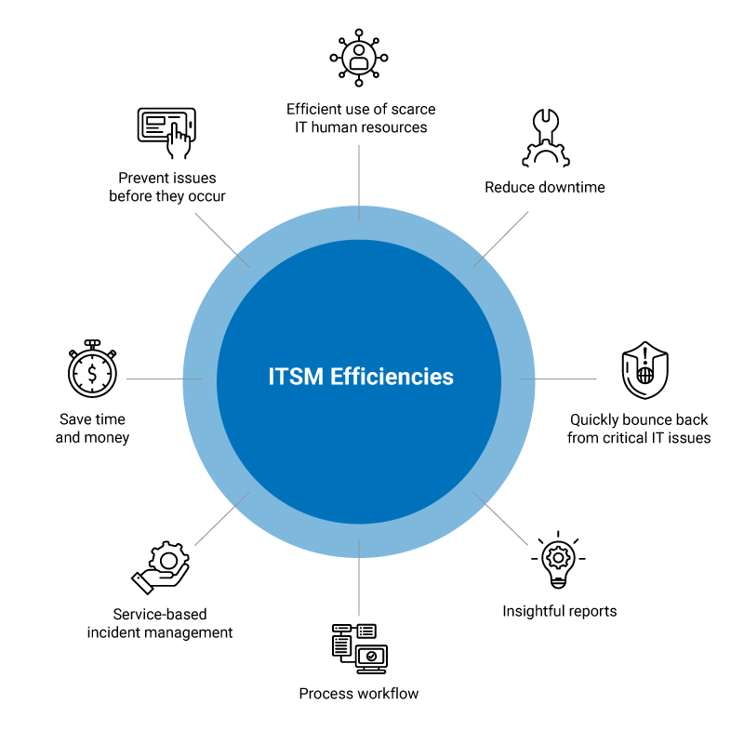
Benefits of Using ServiceNow in Education
Improved response times and increased student and staff satisfaction.
Enhanced operational efficiency through automation and centralized data.
Better compliance management and security for sensitive educational data.
Notes:
Image source: https://arcticit.com

Slide 11
Conclusion and Future Outlook
Integrating ServiceNow transforms administrative and support functions in education.
Ongoing innovation will further personalize and automate educational services.
Educational organizations should consider ServiceNow to stay competitive and efficient in a digital world.
Notes:
Image source: https://www.slidemake.com

